Slide 2
COMP1206 - Programming 2
Lecture: String
Dr Jian Shi
Jian.Shi@soton.ac.uk
28 February 2020

Slide 3
Topics
Character
String in Java
Constructors
Comparison
Methods

Slide 4
Character
Primitive datatype
char value = 16 bit number
char c = ‘z’
actual data stored in c is the 16 bit Unicode value (in Hex. U007A)
Common encoding of Unicode: UTF-8
Writer out = new OutputStreamWriter(fos, "UTF8");
InputStreamReader isr = new InputStreamReader(fis,"UTF8");

Slide 5
String
A string is just a sequence of characters.
Although this logically implies that a string is just a sequence of Unicode values - this is not the case in Java. Strings in Java are actually modelled as full-blown objects.
Whenever you use a string, even a string literal (e.g. "Hello to Jason Isaacs"), then the JVM will allocate heap-space for the object representing that string.
The Java compiler is at least smart enough to use a single object to represent all of the occurrences of the same string literal in your program.
So the easiest way of creating a String object in Java is to actually just write a string literal, that is, a sequence of characters in double-quotes.
System.out.println(“Welcome to COMP1206”);

Slide 6
Constructors
There are many constructors for String class, which means there will be various ways to build String objects.
Direct assignment
2. Using keyword new
From arrays of bytes or char
From string
String str = “Java”;
char[] name = {‘J', ‘a’, ‘v', ‘a' };
String str = new String(name);
String str = new String(“Java”);

Slide 7
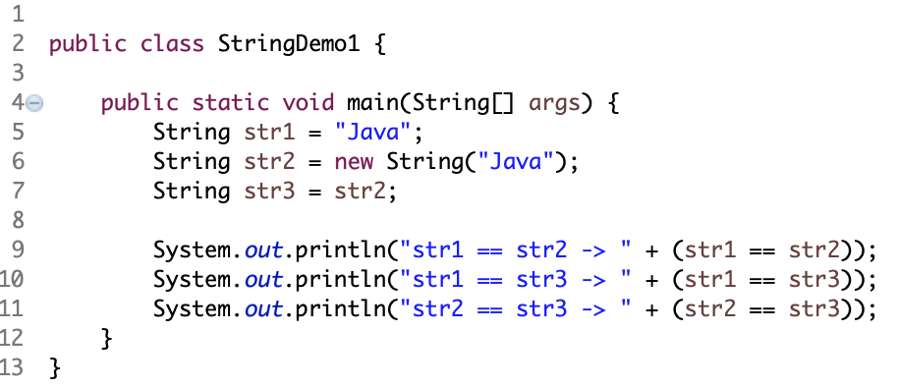
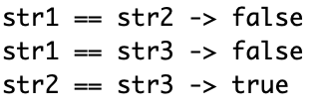
String comparison
We have already introduced == to compare. We can use it to compare whether the values of two numbers are the same.
Can we use it for String in Java? See the example:
Output

Slide 8
String comparison
STACK
HEAP
str1
String str1 = “Java”;
“Java”
OX1001
str2
String str2 = new String(“Java”);
“Java”
OX1002
str3
String str3 = str2

Slide 9
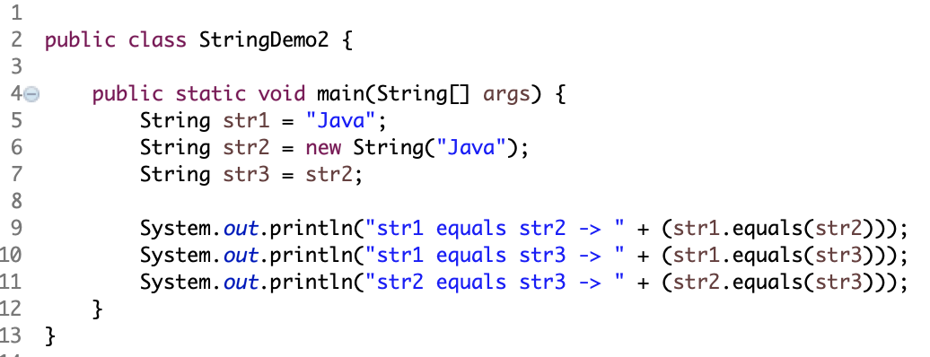
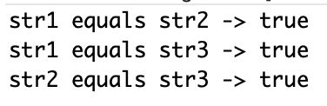
String comparison
Then how could we compare the values of two strings?
equals() method
Output

Slide 10
More String Comparison
Another interesting method in the String class is int compareTo(String str).
This method allows you to compare two strings in a lexicographic ordering to see whether one is less than the other. The method returns 0 if the strings have the same content, a negative integer if this string is less than str, and a positive integer if this string is greater than str.
The ordering depends on the standard lexicographic order by comparing the strings per character. Of course, characters are just numbers in the Unicode system so the comparison is actually on the Unicode representation of the strings. For this reason we see that "Hello" is less than "hello" because the Unicode for 'H' is numerically less than the encoding for 'h'.
Be wary of comparing strings of foreign languages - the order in which special characters appear in the Unicode tables may differ from the official lexicographic order.
You can use a java.text.Collator object to do locale-based comparisons if necessary.

Slide 11
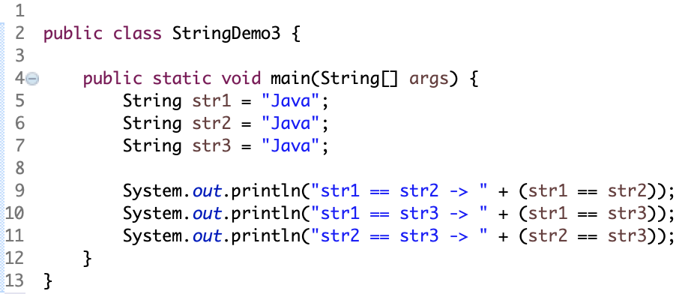
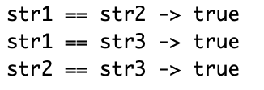
Differences – Direct Assignment
A piece of string is an anonymous object from String class
Example
System.out.println(“Java”.equals(“Java”));
true
STACK
HEAP
str1
“Java”
OX1001
str2
str3
Output

Slide 12
Differences – new String()
STACK
HEAP
str
“Java”
OX1001
“Java”
OX1002
String str = new String(“Java”);

Slide 13
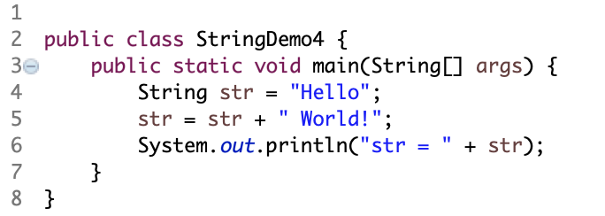
Immutable
Objects of type String are immutable - their contents cannot be changed.
See the following example:
The output is “str = Hello World!”. It seems that we have changed the content of the String object, but is that true?

Slide 14
Immutable
String str = “Hello”;
STACK
HEAP
str = str + “ World!”;
str
X
“Hello”
“ World!”
“Hello World!”
Q. How to modify the immutable?
A. java.lang.StringBuffer -> append(), etc.

Slide 15
Useful Methods
One of the useful things about having a class for strings rather than treating them as a primitive datatype is that is then easy to provide a number of methods for acting on strings.
There are a lot of these.
It is worth looking at the API documentation for the String class to see what you can actually do with Strings.

Slide 16
Useful Methods
Some selected methods are:
static methods valueOf for converting the primitive datatype values to String representations - these are useful because you can't call the method Object.toString() on primitive values.
trim() - returns a copy of the string with leading and trailing whitespace omitted
toLowerCase() and toUpperCase() - converts all of the characters in the string to lower/upper case
length() and charAt() are useful for iterating over the string
substring(int begin, int end) returns the substring which begins at position begin and ends at position end
There are also methods for extracting the character array which the string comprises, as well as the underlying byte array (according to the local, or specificied, character encoding).

Slide 17
Searching in Strings
As well as comparing strings one of the most common operations on strings is to perform a search for some particular substring. There are a number of ways of doing this in Java. Three very simple ways of doing this are
boolean startsWith(String substr)
boolean endsWith(String substr)
int indexOf(String substr)
which tests whether the string these methods are invoked on starts with, ends with, or contains the given substring substr. In the latter case the position, if it exists, of the first match for the substring is returned.

Slide 18
Regular Expressions in Java
A more complicated, but more sophisticated method for searching within a string is the method
This method will return true only when this string can be matched against the regular expression given in regexp.
I imagine that you have come across regular expressions before - and you certainly will again. I won't try go through the details of them here as this can take a whole lecture in itself!
More explanation and example is available from here.
boolean matches(String regexp)

Slide 19
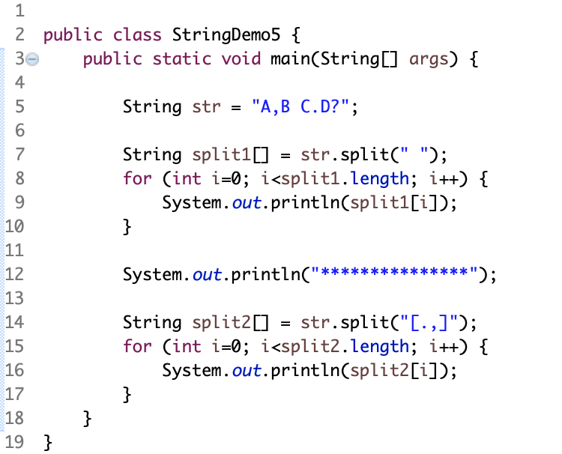
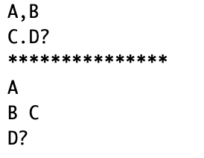
Splitting Strings
Output

Slide 20
Summary
Strings in Java are conceptually just sequences of Unicode characters but are actually represented as heap-allocated objects.
String objects are immutable.
String comparison should be done using methods equals and compareTo
There are a large number of utility methods in the String class - look at the API.
String searching facilities are provided by making use of regular expressions.
Limited mutable string objects are provided - StringBuffer (thread-safe) and StringBuilder (not thread-safe)

